Slide 1

The Pilot Of Hadoop
2017.2
XenRon

Slide 2

CONTENTS
Preliminary Topics
事前準備
01
05
Hadoop Command
02
06
Hadoop Eco System
Reference Books
03
Hadoop Architecture
Hadoop Environment
実験環境
04

Slide 3
PART1
Preliminary Topics
事前準備

Slide 4



Linux
Official Website :
https://www.ubuntu.com/
http://releases.ubuntu.com/
Official Website :
https://www.centos.org/
https://www.centos.org/download/
https://wiki.centos.org/Download
Official Website :
https://www.redhat.com/en

Slide 5
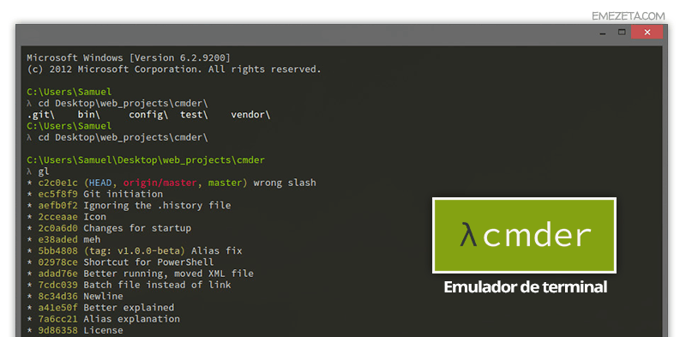
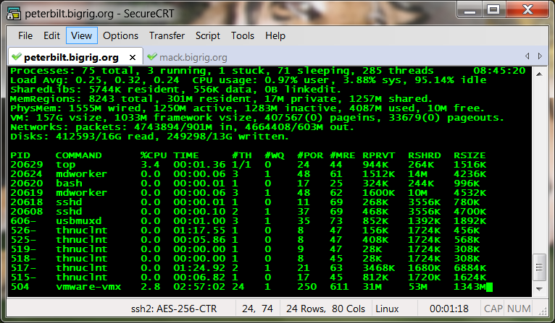
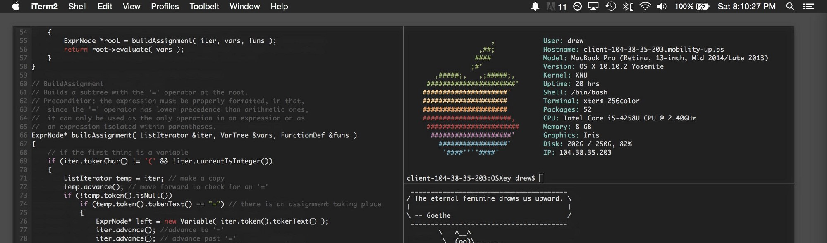
SSH Terminal

Slide 6





Virtual Machine

Slide 7
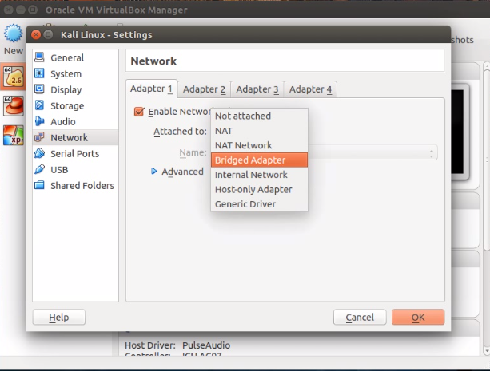
Virtual Box
Official Website :
https://www.virtualbox.org/
https://www.virtualbox.org/wiki/Downloads
Virtual networking :
https://www.virtualbox.org/manual/ch06.html

Slide 8
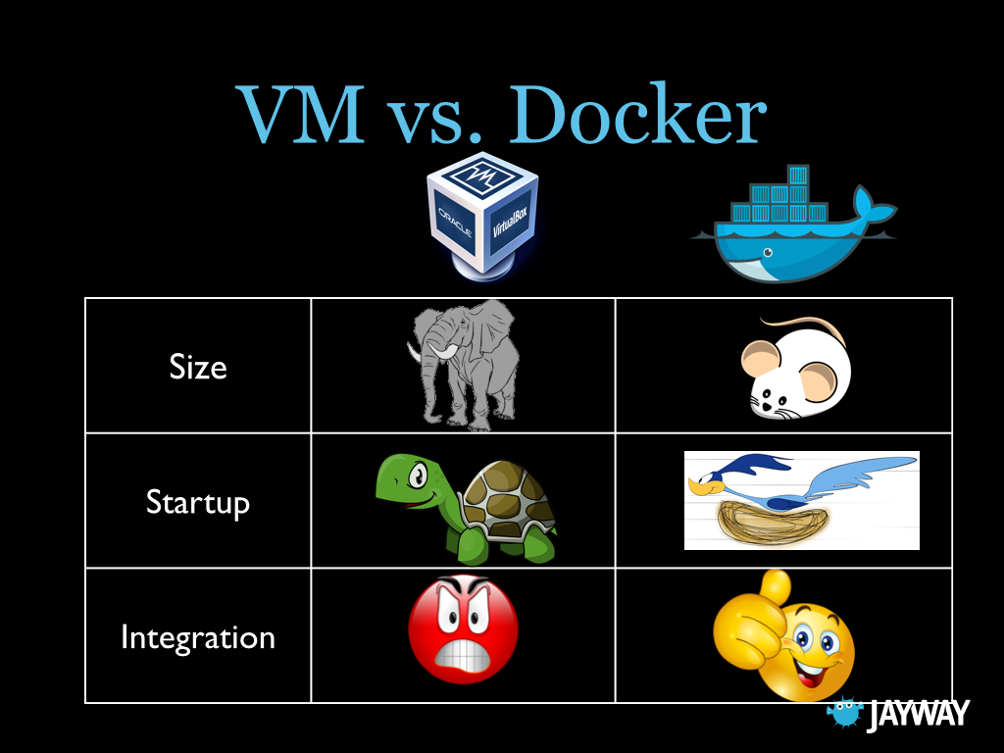
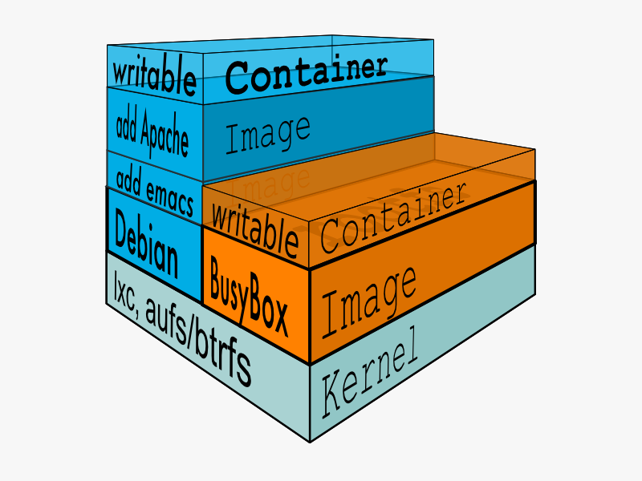
Docker

Slide 9
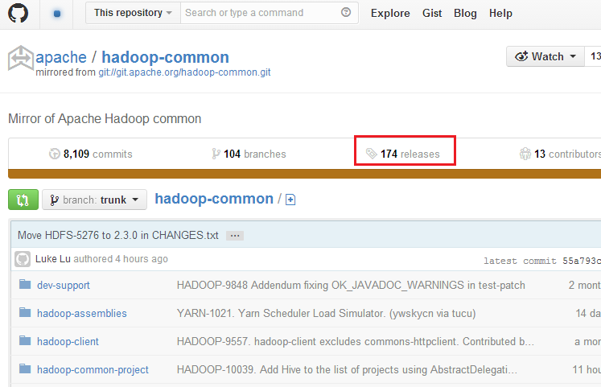

GitHub

Slide 10

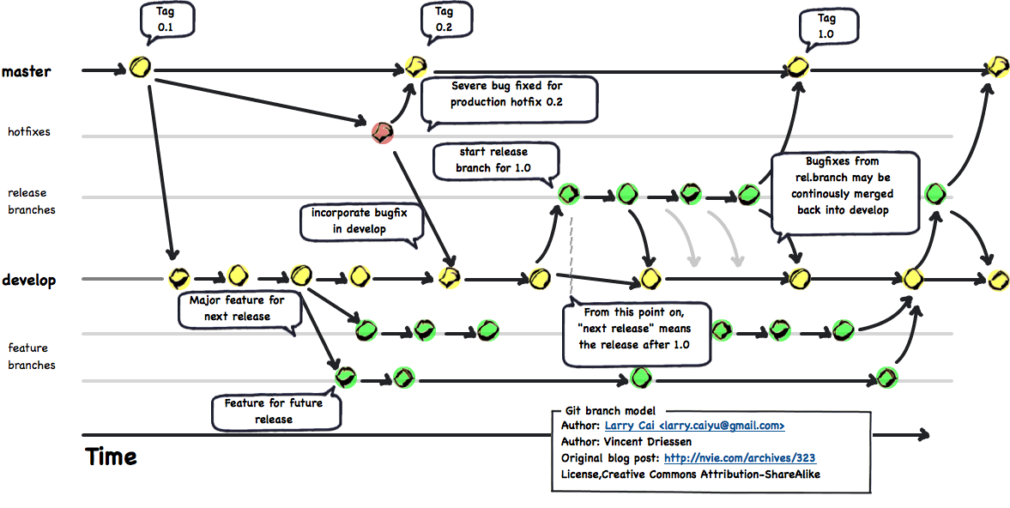
Git
Official Website :
https://git-scm.com/
The latest stable Release : v2.11.1

Slide 11
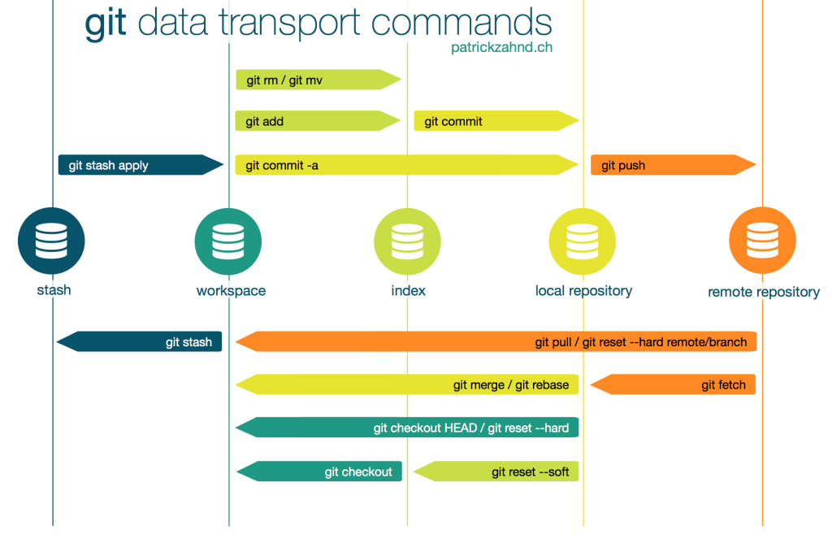
Git

Slide 12
PART2
Hadoop Eco System

Slide 13
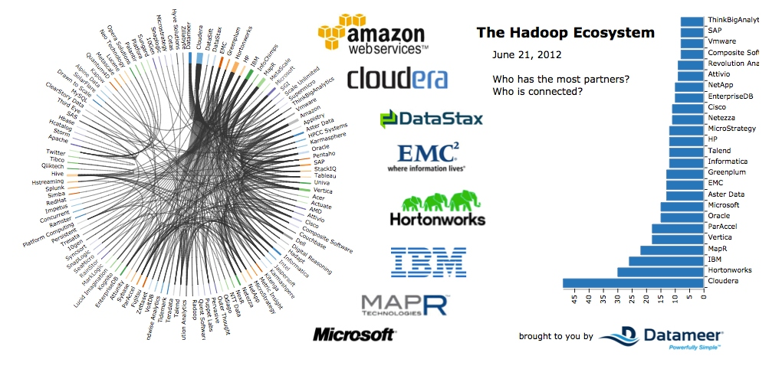
Distributions

Slide 14
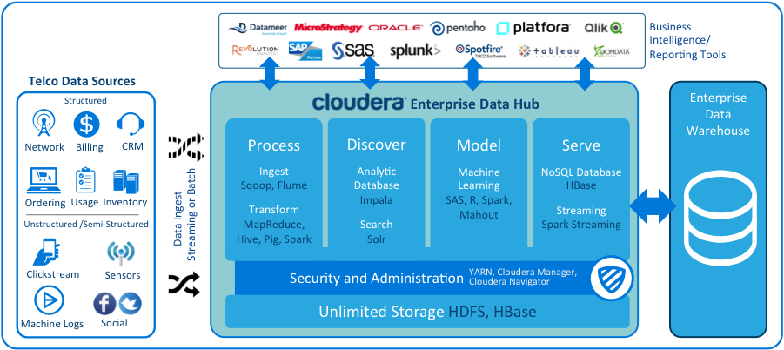
Cloudera

Slide 15
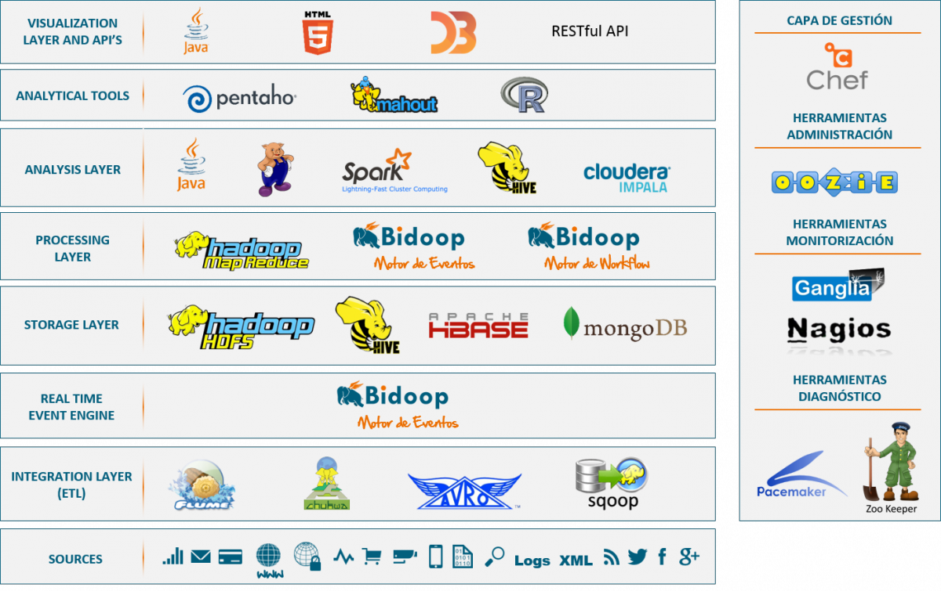
Hadoop Eco System

Slide 16
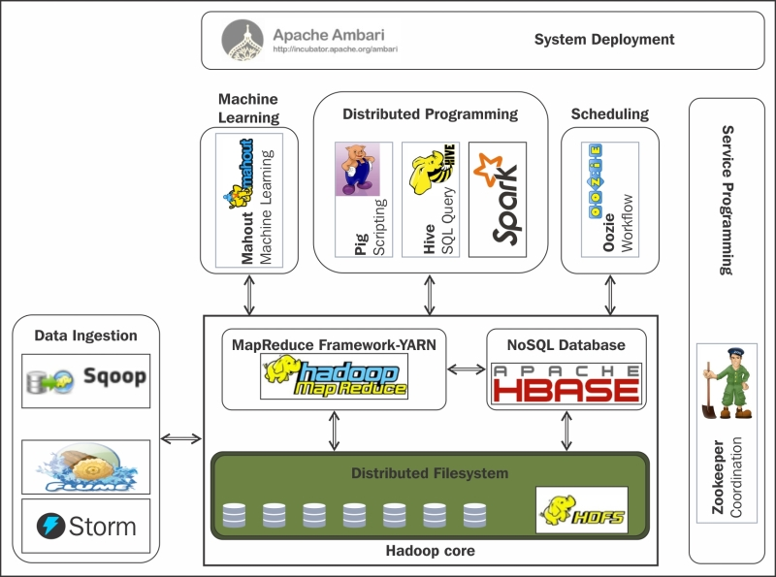
Hadoop Eco System

Slide 17
PART3
Hadoop Architecture

Slide 18
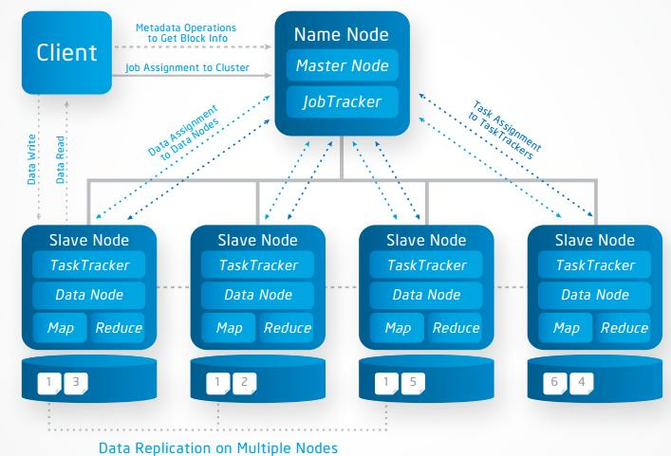
Architecture

Slide 19
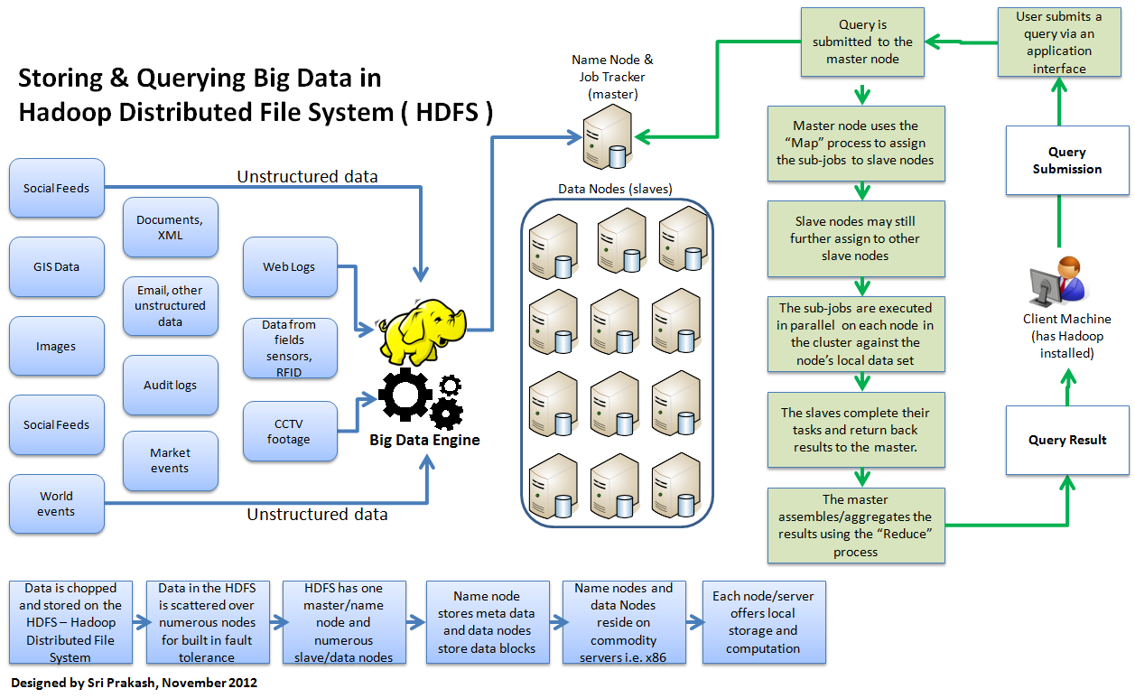
Architecture

Slide 20
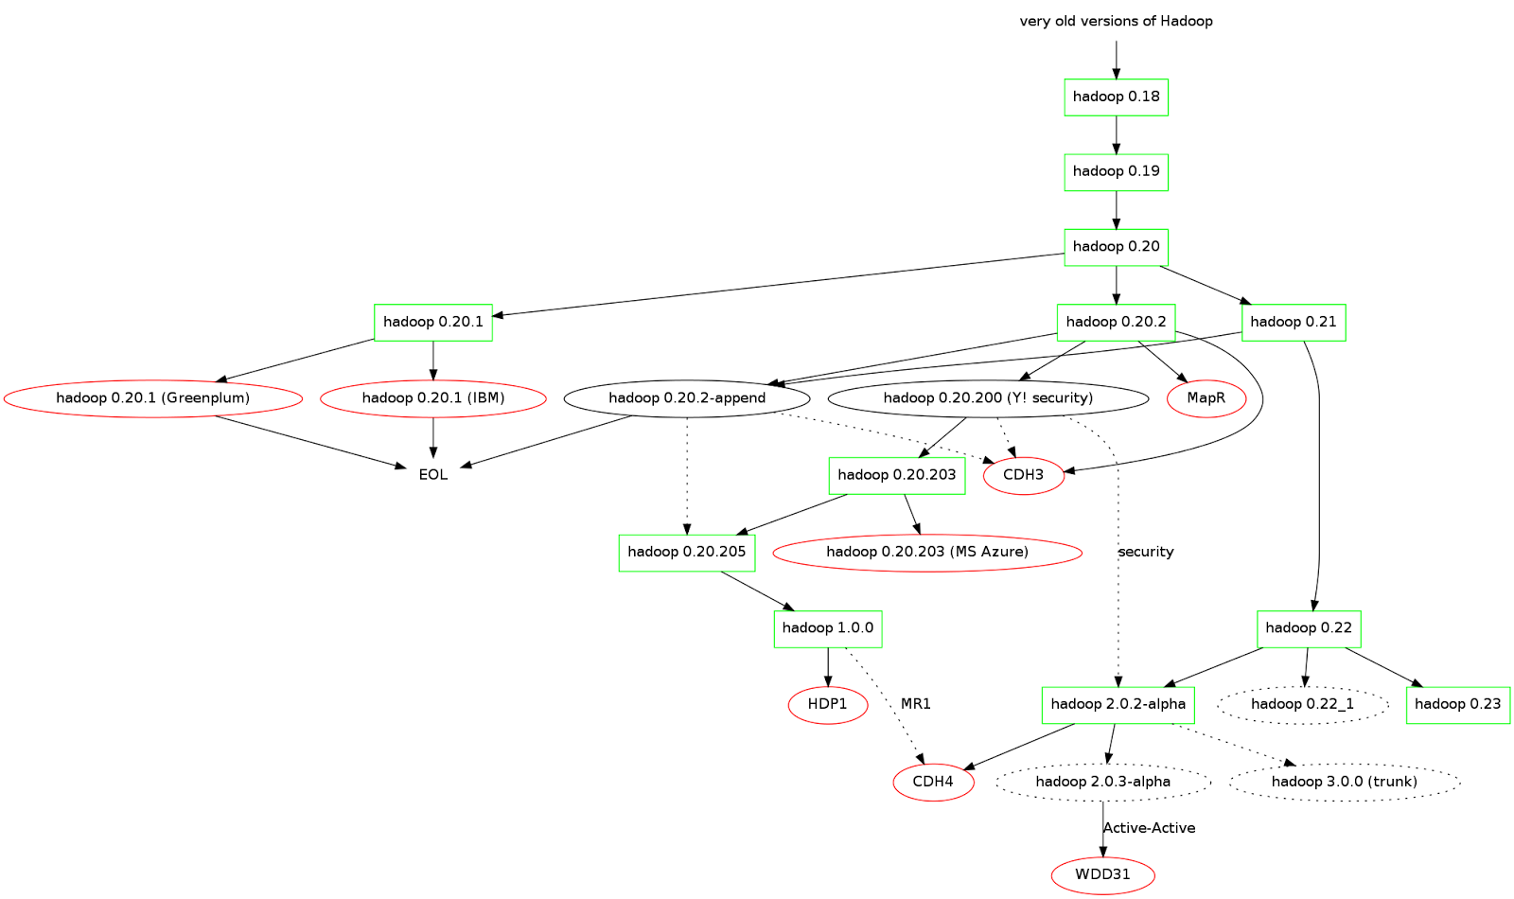
Apache Hadoop Version

Slide 21
PART4
Hadoop Environment

Slide 22
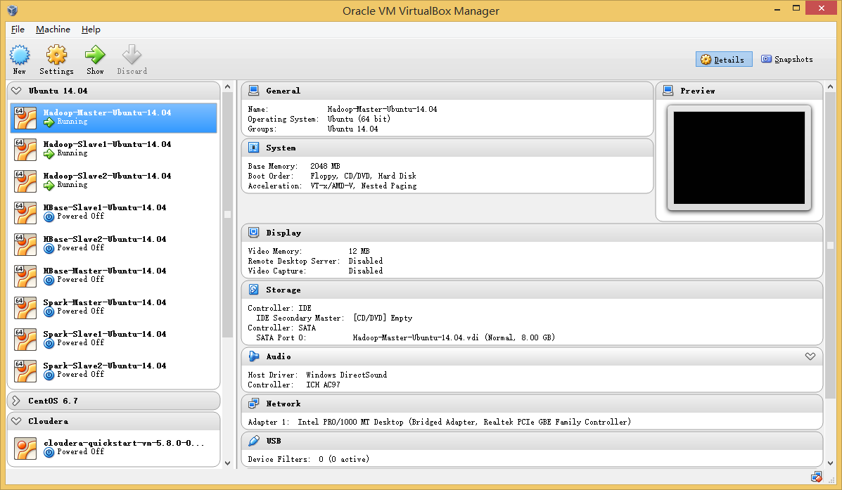
Oracle Virtual Box

Slide 23
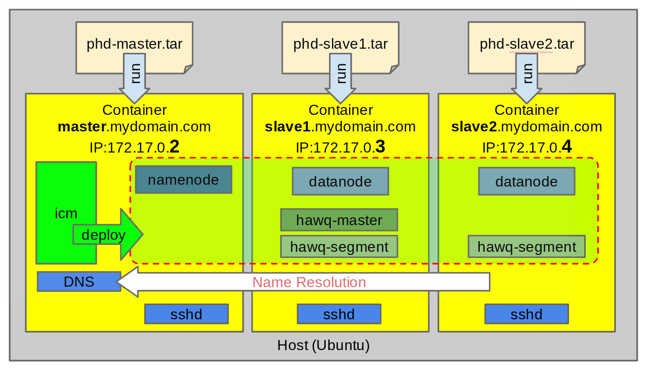
Docker

Slide 24
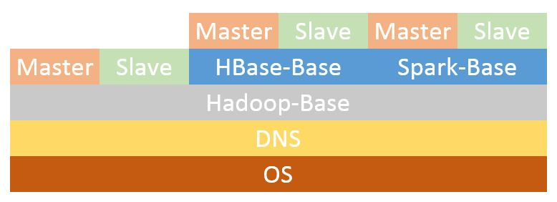
Docker

Slide 25
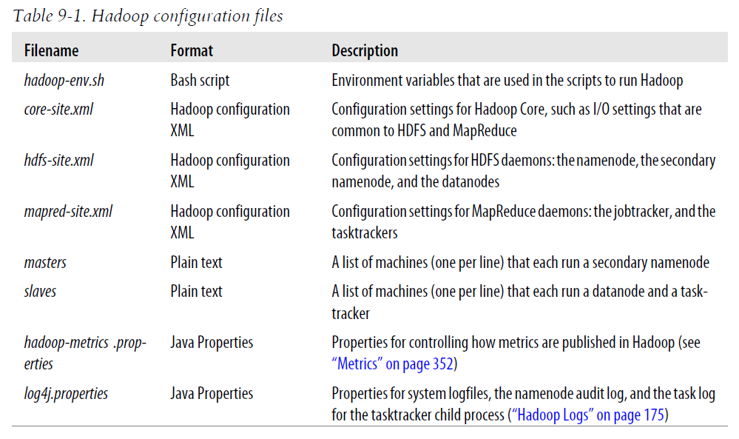
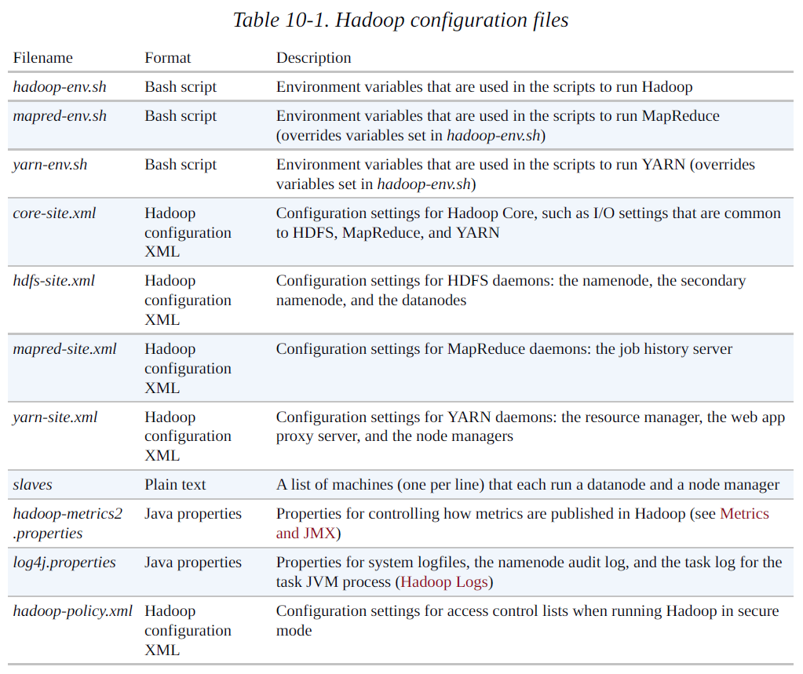
Hadoop configuration files
Hadoop 1.x
Hadoop.The.Definitive.Guide.3rd.Edition
Hadoop 2.x
Hadoop.The.Definitive.Guide.4th.Edition

Slide 26
PART5
HDFS & Hadoop Command

Slide 27
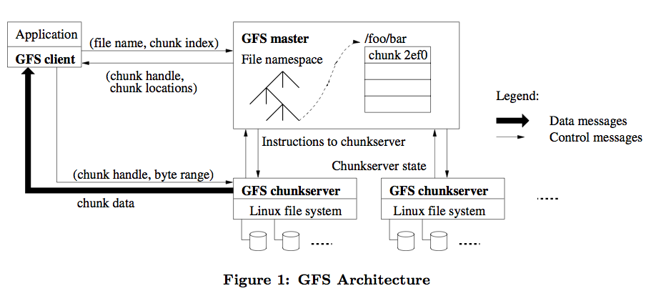
Google File System
The Google File System
https://static.googleusercontent.com/media/research.google.com/ja//archive/gfs-sosp2003.pdf

Slide 28
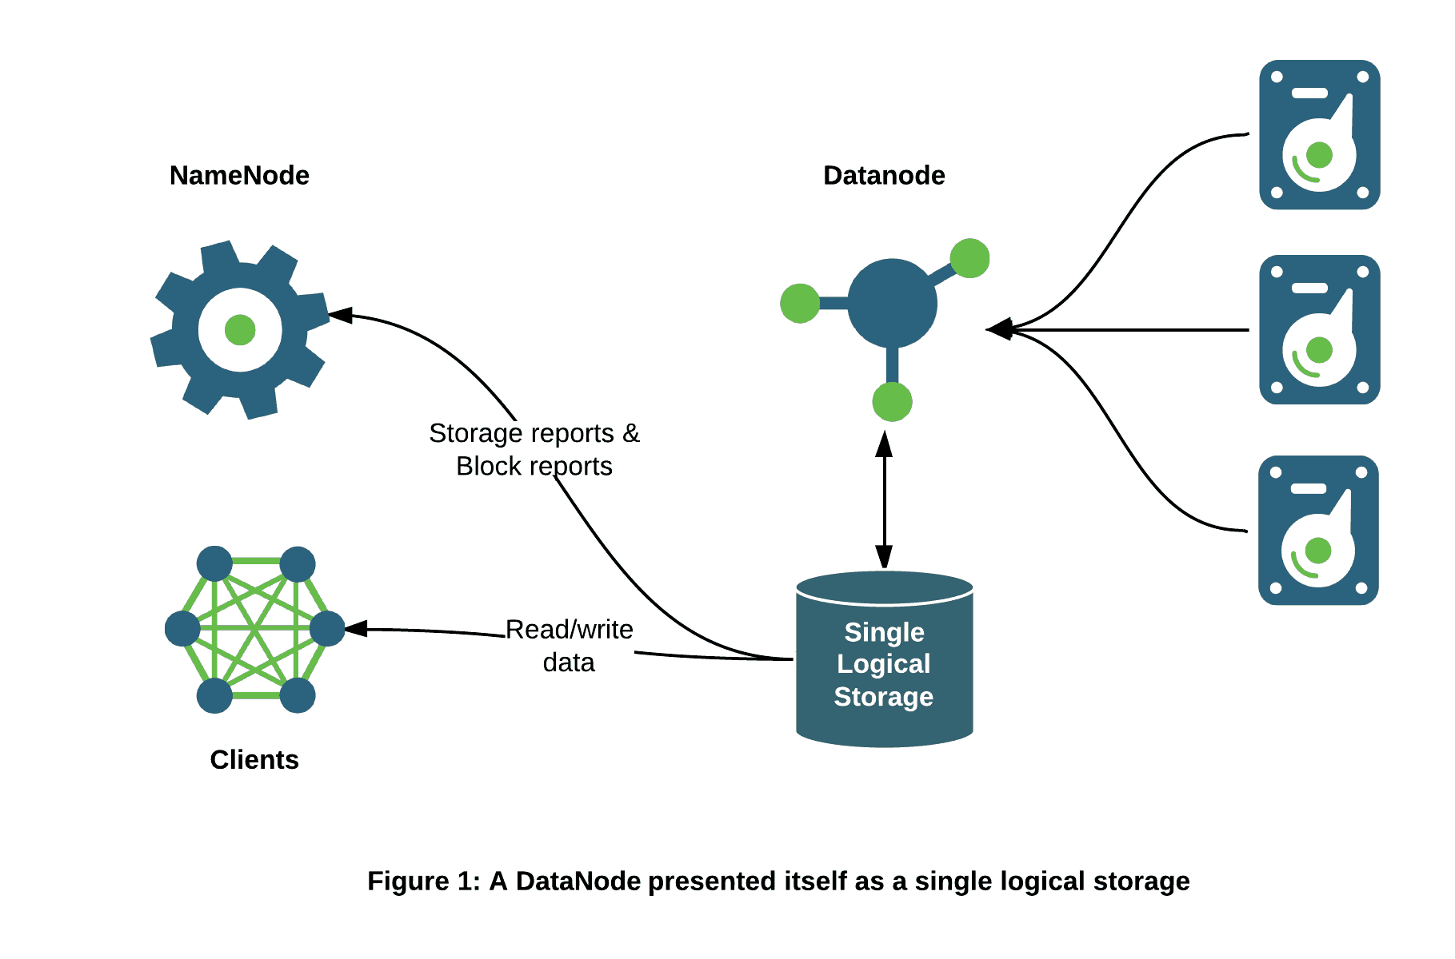
HDFS

Slide 29
HDFS

Slide 30
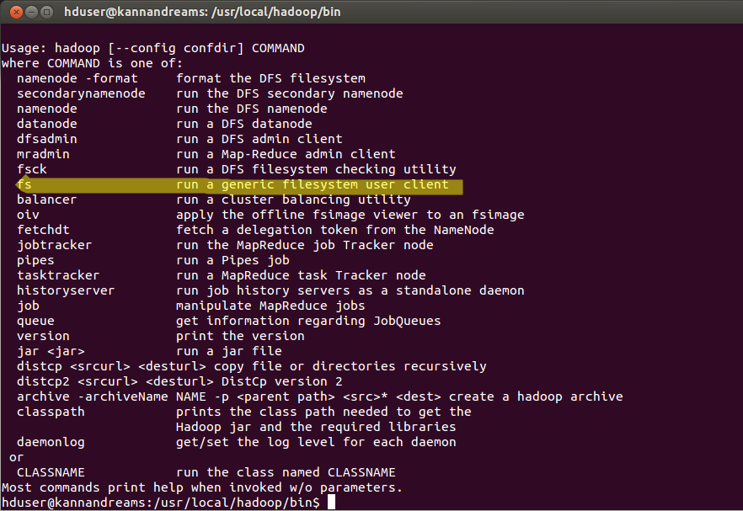
HDFS
Official Website :
https://hadoop.apache.org/docs/stable/hadoop-project-dist/hadoop-common/FileSystemShell.html
https://hadoop.apache.org/docs/r1.0.4/cn/hdfs_shell.html

Slide 31
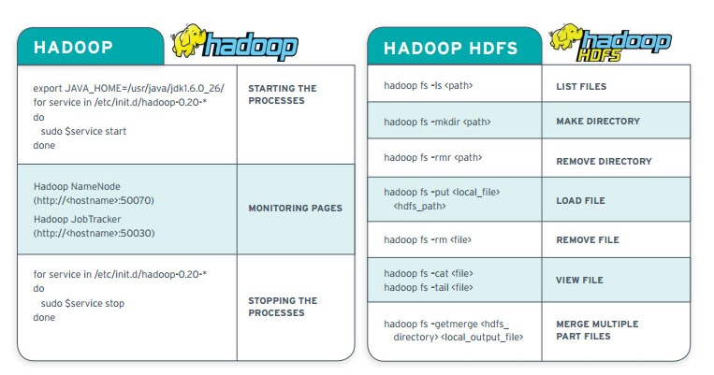
HDFS

Slide 32
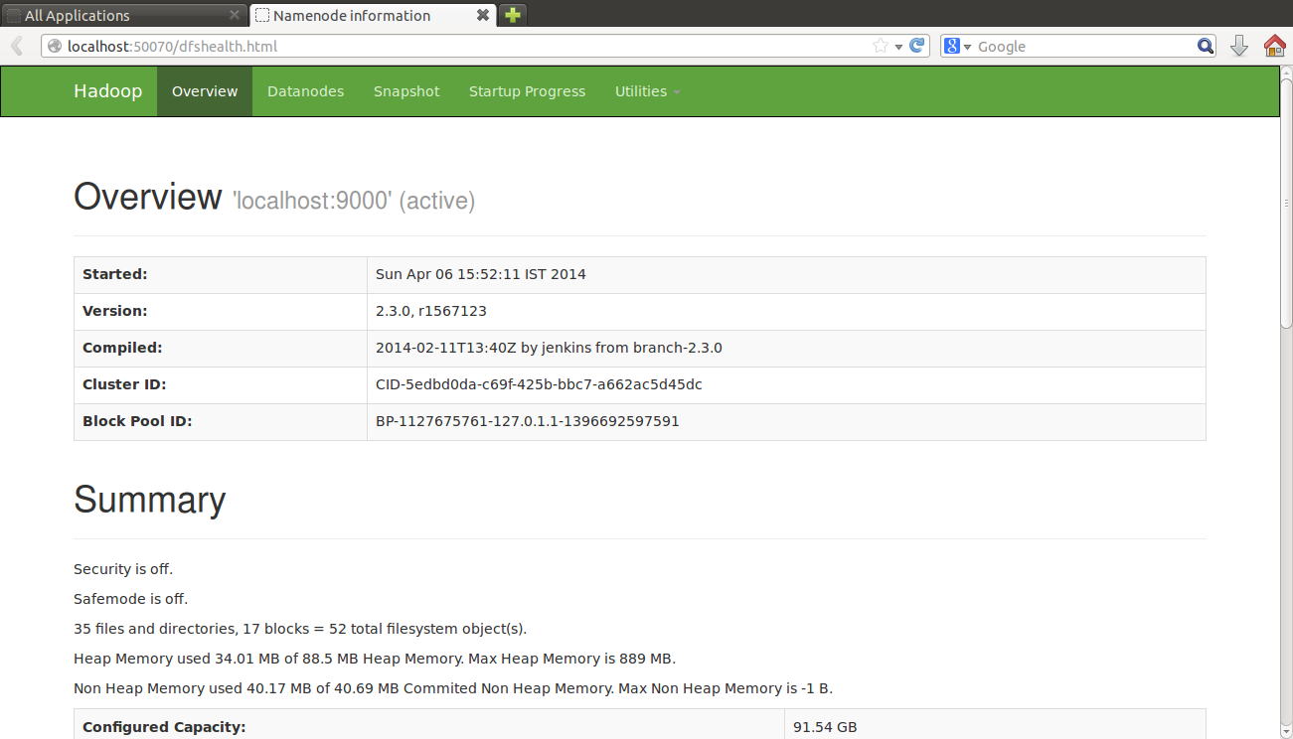
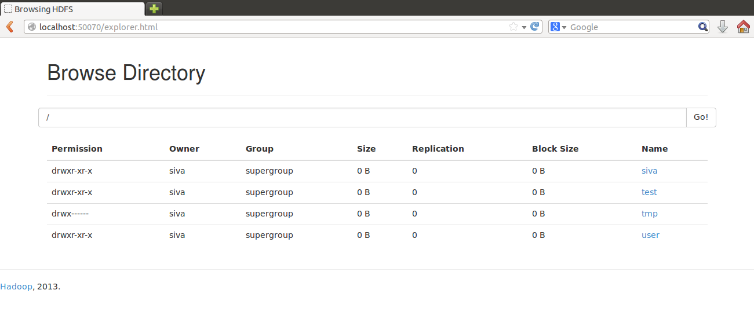
HDFS Web UI

Slide 33
PART6
Reference Books

Slide 34
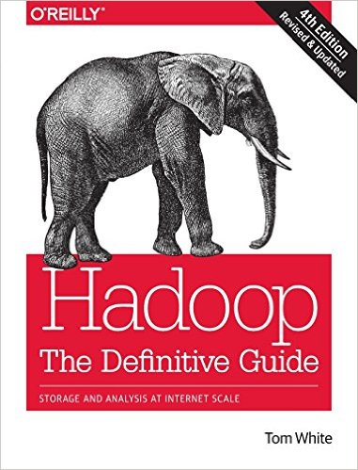
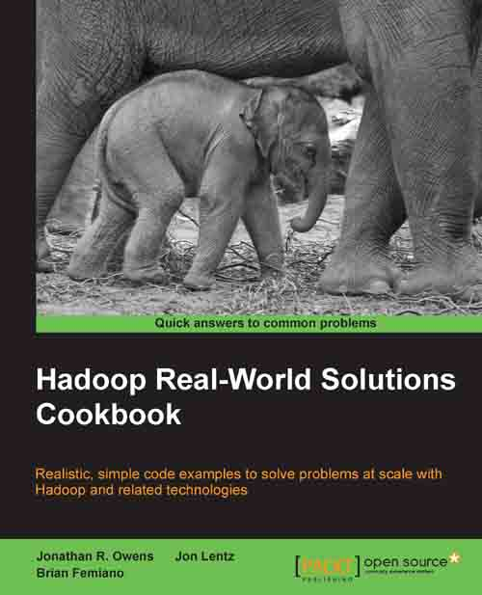
Books

Slide 35
HomeWork

Slide 36
The End

